Slide 1
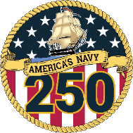
Doing Business with NAVSUP:
Constrained Supply Chains, Source Development, and Contracting Opportunities
Presented to:
Department of the Navy Gold Coast
Presented by:
Naval Supply Systems Command
Noreen McDonough
Director, Office of Small Business Programs
August 2026

Slide 2
NAVSUP Enterprise Products and Services
NAVSUP WSS
Supply Support (Parts, Components and Assemblies)
Program Office Support
Transportation & Distribution/Stock Positioning
Foreign Military Sales
      NAVSUP Fleet Logistics Centers
NAVSUP Mission
NAVSUP and the Supply Corps conduct and enable supply chain, acquisition, operational logistics and Sailor & family care activities with our mission partners to generate readiness and sustain naval forces worldwide to prevent and decisively win wars.
The NAVSUP/Navy Supply Corps team forms a vast network of professionals who deliver unparalleled products and services to customers in the fleet and across the world.
NAVSUP’s Office of Small Business Programs
To ensure small business advocacy leads to a lasting impact on the quality of our products, economic market competitiveness and mission effectiveness for years to come.
      Logistics Operations
        Waterfront Support
        Contracting
        Fuel
        HAZMAT
        Warehousing
        Transportation
      Quality of Life
        Household Goods
        Postal
        Fleet Assist Teams
NAVSUP BSC
IT Software Development
Financial and Logistics Support (ERP, STARS)
Food Service and Retail Operations (FSM3, ROM-III)
Ordnance (OIS)
Household Goods (PPTAS)
NEXCOM
Uniforms
Navy Exchange
Ships Store
Navy Clothing and Textile Research Facility
Personal Telecom
Navy Lodge

Slide 3
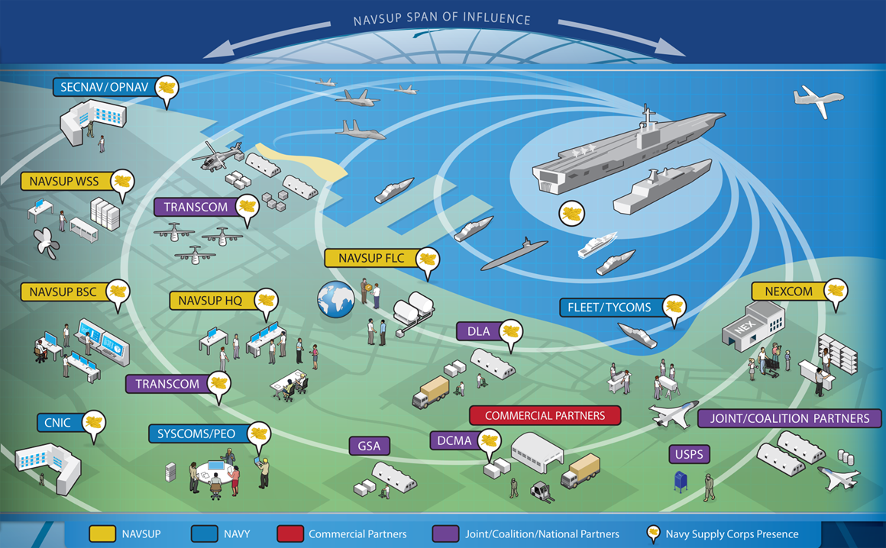
NAVSUP Integrated Customer Support
End-to-End
Customer Support
      Acquisition
      Storage
      Distribution
      Transportation
      Disposal

Slide 4
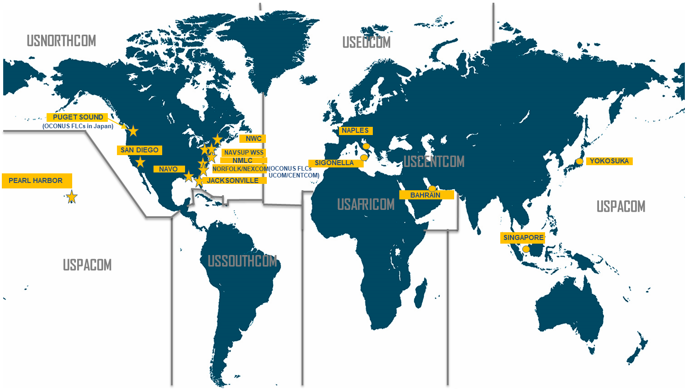
NAVSUP Office of Small Business Programs
NAVSUP OSBP
15 Small Business Professionals (SBP) across the HCA’s 10 major buying commands and NFCS
Execute responsibilities IAW SECNAV 4380.9A
5201.401-90(c)(8) Naval Supply Systems Command (NAVSUPSYSCOM) is responsible for awarding and administering contracts in support of assigned logistics support functions. NAVSUPSYSCOM’s unique contracting responsibilities include procuring supplies and services for all non-contracting Navy activities, offices or commands for which no other HCA is delegated authority. NAVSUPSYSCOM is the DON Executive Agent for the Navy and USMC Government Purchase Card (GPC) program.

Slide 5

Key Points in Doing Business with NAVSUP
Things to do before contacting NAVSUP
Research what the activity buys
  Use publicly available procurement data via Sam.gov
  Utilize the command’s long-range forecast (posted on OSBP page) to anticipate upcoming requirements
Map your capability statement to your research
  Understand meeting the mission is our highest priority
    Meeting mission > SB Goal Execution
    Communicate your company’s strength through the lens of “How can I help meet your mission” (faster, better, more costly)
  “My capability and expertise is closely tied to this previous contract”, or “I am interested in proposing on these types of upcoming requirements”
Reach out to your local APEX Accelerator

Slide 6
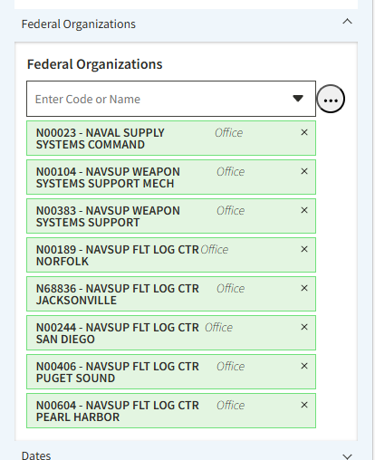
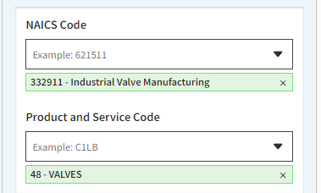
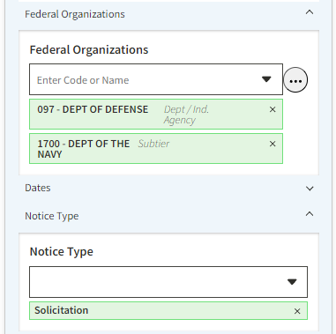
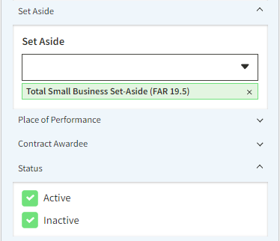
Searching NAVSUP Requirements- SAM.gov
System for Award Management (SAM): https://sam.gov/content/home
Maintain registration to do business with the Government
Search requirements – contract opportunities
Insert photo or graphic here

Slide 7
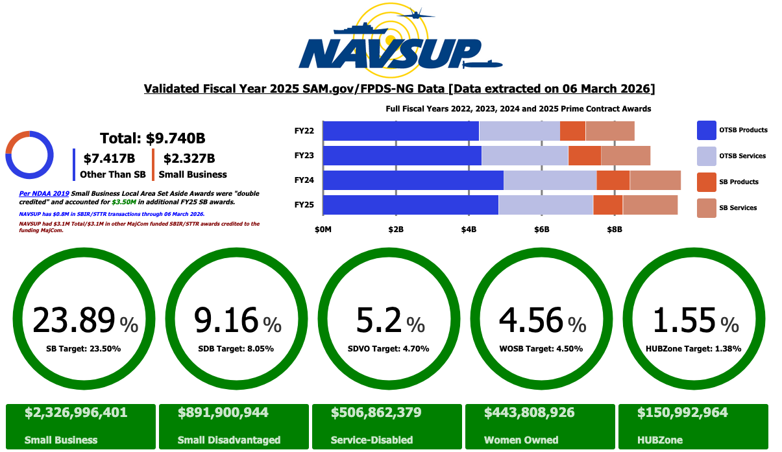
NAVSUP Small Business Reach- FY25
Insert photo or graphic here

Slide 8
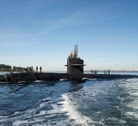
NAVSUP Fleet Logistics Center Portfolio
NAVSUP FLC Portfolio
NAVSUP FLC Mission
NAVSUP FLCs provide a wide range of logistics, business, and support services to the U.S. Navy, Marine Corps, Coast Guard, joint and allied forces.
Their mission is to deliver combat capability through logistics.
      Support Services
        Engineering services
        IT & Technical Support
        Professional & Administrative
        Industrial equipment
        Administrative and technical services
        Professional and educational services
        Medical (BUMED)
        Repair services- Various manufactured items
      Logistics Operations
        Waterfront Support / Fuel
        Contracting
        HAZMAT
        Warehousing
        Transportation
NAVSUP FLC Locations
        Norfolk, Virginia
        San Diego, California
        Jacksonville, Florida
        Pearl Harbor, Hawaii
        Puget Sound, Washington
        Yokosuka, Japan
        Sigonella, Italy
        Bahrain

Slide 9

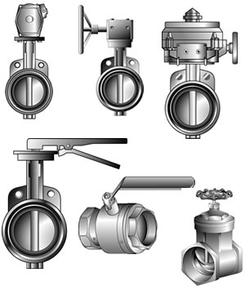
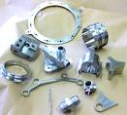


NAVSUP Weapon Systems Support Portfolio
NAVSUP WSS Mission
To provide our Navy, Marine Corps, Joint and Allied Forces with program and supply support for the weapon systems that keep our Naval forces mission ready.
NAVSUP WSS Portfolio
        Aviation
        336413 Aircraft Parts/Aux. Equip Mfg.
        336412 Aircraft Engine/Engine Parts
        334511 Search, Detection, Navigation
        332431 Containers
        333310 Optical Instrument/Lens
        334210 Communications. Equip. Mfg.
        334412 Circuit Board Manufacturing
        335999 Electrical Equipment
        332912 Fluid Power Valve/Hose Fitting
        Maritime
        334515 Mfg. Measuring Instruments
        336413 Aircraft Parts/Aux. Equip. Mfg.
        334412 Circuit Board Manufacturing
        333515 Machine Tool Manufacturing
        332912 Fluid Power Valve/Hose Fitting
        332911 Valves, Non powered
        331491 Nonferrous Metal
        332722 Nuts and Washers
        332999 Fabricated Metal Product Mfg.

Slide 10
NAVSUP WSS Code N98 Aviation Operations
Presented by:
Code N984
LCDR Stephen Martir

Slide 11
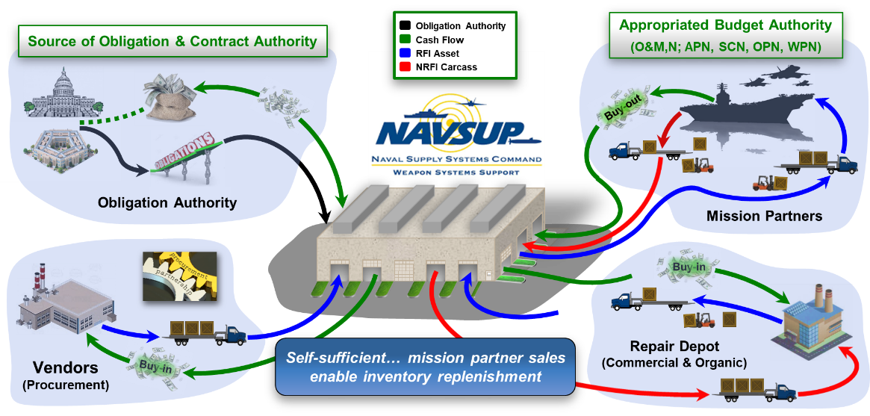
Navy Working Capital Fund
Supply Management Revolving Fund

Slide 12

Sales and Operations Planning
Categories & Forecastability
A
Consistent & forecastable
X
B
C
Intermittent & unforecastable
SALES
Z
Category Descriptions
AX: High sales contribution and consistent demand
AZ: High sales contribution but sporadic demand
BX: Moderate sales contribution and consistent demand
BZ: Moderate sales contribution but sporadic demand
CX: Low sales contribution and consistent demand
CZ: Low sales contribution and sporadic demand

Slide 13
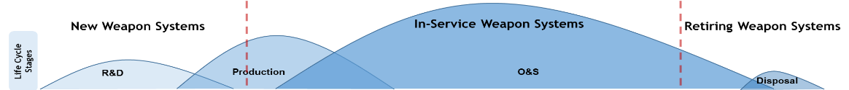


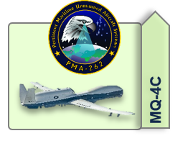
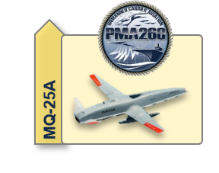
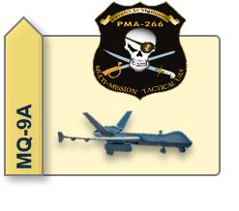
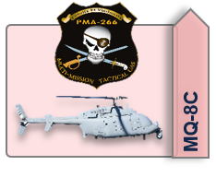
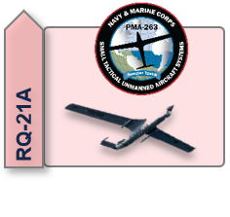
NAVSUP WSS Contracting Types
Contracting Lifecycle Management
MSD
Sun-downing
Methodology
Transactional
BOA
LTC
PBL
Transactional
What stage of Life-Cycle is T/M/S in Is the Configuration stable?
What’s the Demand profile of the market basket?
Are there Vendor Capacity issues?
Are there Sub-vendor issues?
  Sub-Tier Pricing
  Raw Material quotes over 1 year
What are current inflation impacts?
Unstable Requirement
Unknown demand
Stabilizing Requirement
Recurring demand
Requirements/
IDIQ
Forecastable demand
Supply Chain Ownership
Metrics-driven support
Obsolete / Unsupported
Waning
demand
Requirement
Demand Pattern
Undefinitized Contract Actions (UCA’s)
New/Unknown/Urgent Requirement
Circumstance preclude FFP
Where majority of UAS contracts sit
Matching Contract Type with Life Cycle Stage to Maximize Readiness and Integrate Supply Chain
BOA: Baseline Obligation Authority | LTC: Long-term Contract | PBL: Performance-based Logistics | IDIQ: Indefinite Delivery, Indefinite Quantity | UCA: Undefinitized Contract Action | FFP: Firm-Fixed Price

Slide 14
NAVSUP WSS Code N96 Surface Operations
Presented by:
Code N9615
Mr. Daniel Mathews

Slide 15
Integrated Weapon Support Team
Basic Business Vision
IWST Objective: Provide benchmark Weapon Systems Support through cooperative engagement, long-term planning, and process innovation aligned to the Maritime Design Strategy
Design product support strategies to program readiness goals
Align supportability requirements to planned cost, schedule, and performance.
Evaluate planned versus actual performance
Supply Support Strategy:
Unique to Individual Systems, Subsystems and Component
Collaborate with TYCOMs, FLCs and OEMs for life-cycle logistics development, implementation, sustainment and disposal
PBL Contract, LTC Contract, Basic Order Agreements, Purchase Orders, Depot Maintenance, and Inter-service Support Agreements
Capability Development Strategy:
Plan, Develop and execute provisioning plan
Budget for forecasted repair and procurement requirements
Procure planned spare requirements
Execute estimated organic and commercial repair requirements
Perform frequent analysis and adjust requirements for demand changes, capability development, and obsolescence
IWST
N7 Contracts
&
DLA Contracts
N965
Provisioning
N983
Industrial Support for FRCs
N2
Engineering
N8
Budget & Pricing
N4
Retail Operations
N6
Operations Research
Daily Routine
Strategic Backorder Elimination
Persistent Partnership Engagement
Strategic Contracts &Planning
Frequent Forecast Evaluation
Continual Process Improvement
Warfighter-Focused Weapon Systems Support
15
Notes:
NAVSUP WSS N96 - Detailed Speaker Notes
(Integrated Weapon Support Team - Basic Business Vision)
"Good morning/Afternoon. This slide captures our fundamental business model at NAVSUP WSS. It’s not just a diagram; it's our operational playbook. At the heart of this is the Integrated Weapon Support Team, or IWST. For us in the Surface Operations Directorate, the IWST is the engine that drives readiness for every surface ship in the fleet. We don't operate in a vacuum. We are the central hub, integrating the efforts of Engineering, Contracts, Budgeting, and Operations Research to deliver warfighter-focused support."
"Let's break down what this means for N96."
IWST Objective: Our Strategic Mandate
"The IWST Objective is our north star. It's about providing benchmark—meaning best-in-class—weapon systems support.
'Design product support strategies to program readiness goals': This is our primary function in N96. We are the architects of the support plan for every surface combat system and platform, from Aegis and DDG-51 to LCS and the future systems. We translate fleet readiness requirements into tangible, executable supply support strategies.
'Align supportability requirements to planned cost, schedule, and performance': This is the core of our daily challenge. We work with N8 (Budget & Pricing) to ensure our strategies are fully funded and with N7 (Contracts) to ensure they are executable within schedule. For N96, this means making the tough trades—balancing performance with affordability to deliver the best possible readiness to the warfighter within our fiscal constraints.
'Evaluate planned versus actual performance': This is about accountability. Are our strategies working? Are we meeting the CASREP and readiness metrics we planned for? This requires constant feedback and data analysis, which we drive in collaboration with N6 (Operations Research)."
The IWST Wheel: N96 as the Integrator
"This wheel shows our key partners within NAVSUP WSS. N96 doesn't just 'do its part'; we integrate the inputs from all these directorates to create a coherent whole for the surface fleet.
N965 (Provisioning): While called out separately, Provisioning is a critical component of our directorate. They establish the initial support baseline for new systems. Our job in the broader N96 is to manage that baseline throughout the lifecycle.
N4 (Retail Operations): We are inextricably linked. N4 manages the 'last tactical mile' of supply, but the effectiveness of their retail operations depends entirely on the wholesale strategies and material positioning plans we develop in N96.
N6 (Operations Research): N6 provides the analytical horsepower. They help us evaluate our forecast accuracy, identify readiness degraders, and model the impact of different support strategies. We provide the operational context and ask the critical questions; they provide the data-driven answers.
N983 (Industrial Support for FRCs): While this bubble points to aviation's Fleet Readiness Centers, the principle applies directly to our relationship with shipyards, Regional Maintenance Centers, and both organic and commercial repair depots. We develop the repair requirements and budgets to ensure the industrial base can meet the fleet's maintenance and overhaul needs.
N2 (Engineering): Engineering is our technical backbone. They manage obsolescence, identify configuration changes, and provide the technical data we need to make informed support decisions. When a part is no longer available, we work with N2 to find a suitable replacement or bridge to a new technology.
N8 (Budget & Pricing): We own the requirement; N8 secures the funding. Our collaboration is a constant cycle of defining the need, justifying the cost, and executing the budget to maximize fleet readiness.
N7 (Contracts): Our strategies are just paper until N7 puts them on contract. We work hand-in-glove with them to build effective contracting vehicles, whether it's a Performance-Based Logistics (PBL) contract for a major combat system or a Basic Order Agreement for common repairs."
Strategies & Daily Routine: From Vision to Execution
"The left side of the slide is our 'what,' and the bottom right is our 'how.'
Capability Development Strategy: This is the N96 playbook in action. We develop the provisioning plan, budget for repairs, procure the spares, and manage the execution of those repairs. Critically, we perform the frequent analysis to adjust for demand changes and obsolescence. The fleet environment is dynamic, and our support strategy must be equally agile.
Daily Routine: This list is what every member of the Surface IWST should be focused on, every single day.
Strategic Backorder Elimination: We don't just chase backorders; we analyze them to find the root cause and implement strategies to prevent them in the future.
Persistent Partnership Engagement: Constant communication with our PEOs, TYCOMs, and industry partners.
Strategic Contracts & Planning: We are always looking 3-5 years ahead.
Frequent Forecast Evaluation: Is our demand plan accurate? If not, why?
Continual Process Improvement: We must constantly challenge our own assumptions and find better, faster, and more cost-effective ways to support the fleet.
"Ultimately, our entire business vision is focused on one thing: Warfighter-Focused Weapon Systems Support. Every decision we make in N96 must be directly tied to improving the readiness and lethality of the surface force."

Slide 16
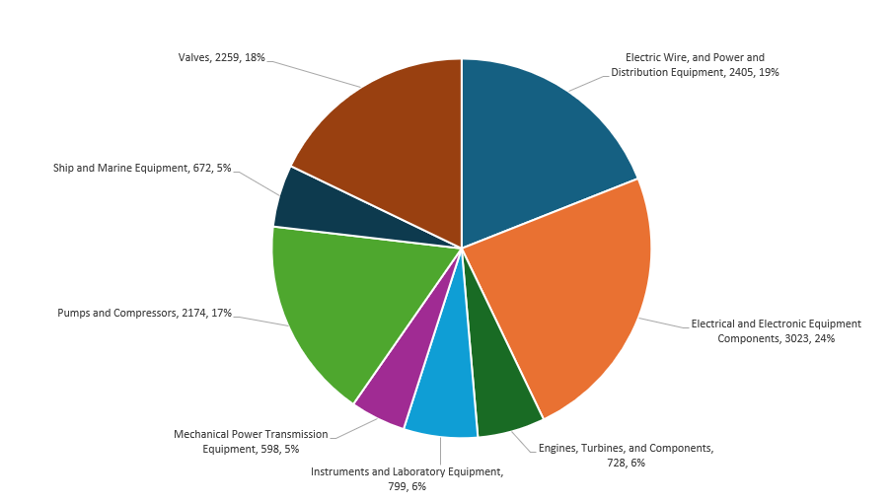
Federal Supply Class- Hull Mechanical and Electronics (HM&E)

Slide 17
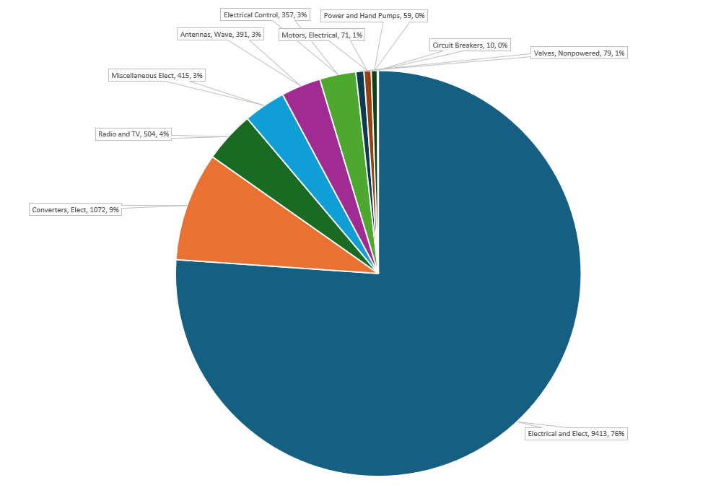
Federal Supply Class- Cruiser-Destroyer (CRUDES)

Slide 18
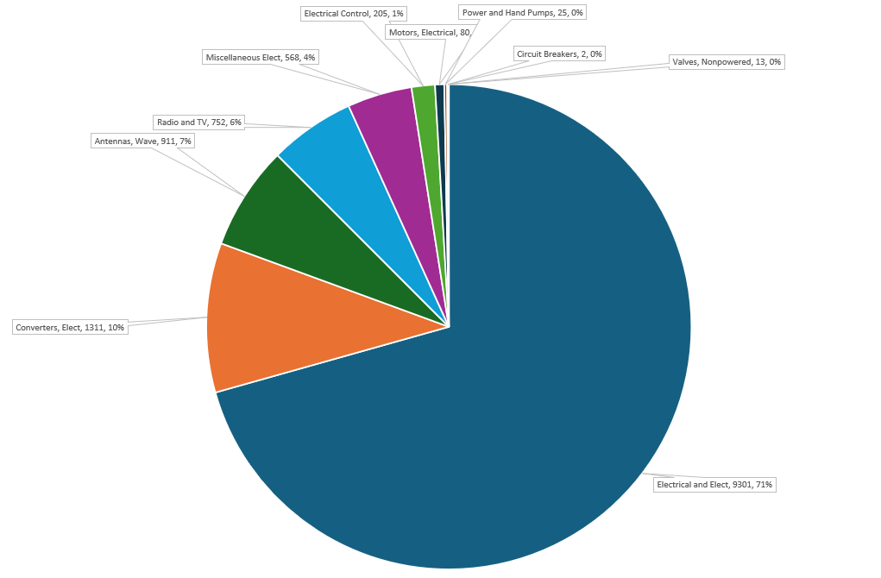
Federal Supply Class- Common Electronics

Slide 19
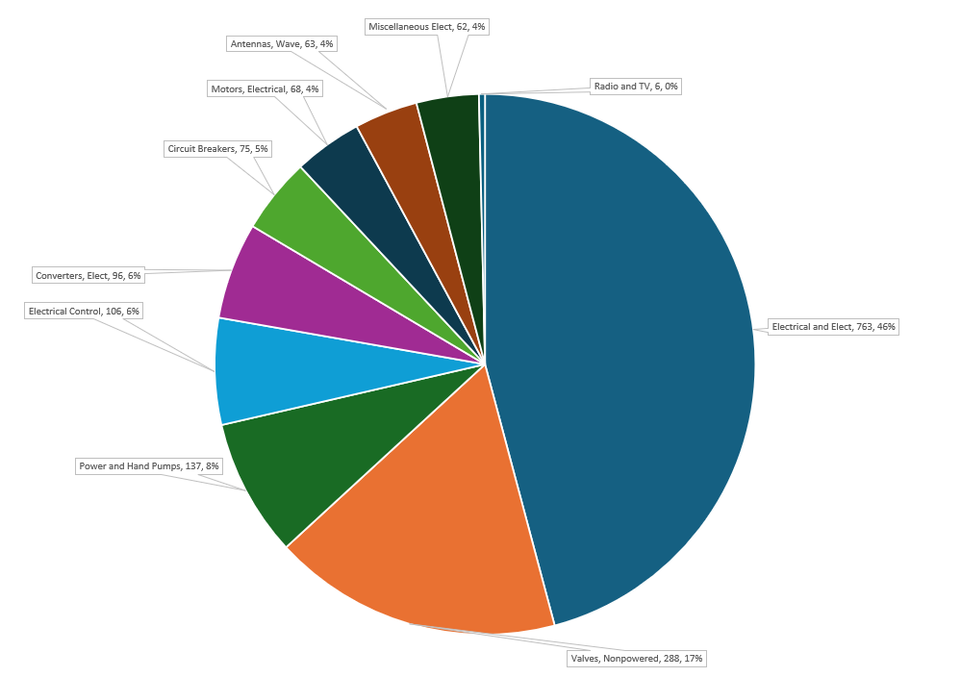
Federal Supply Class- Carrier

Slide 20
NAVSUP WSS Code N97 Special Emphasis Programs Operations
Presented by:
Code N97
Mr. Justin Miller

Slide 21
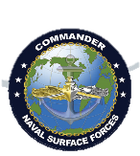
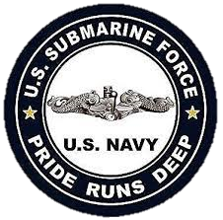
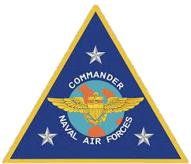
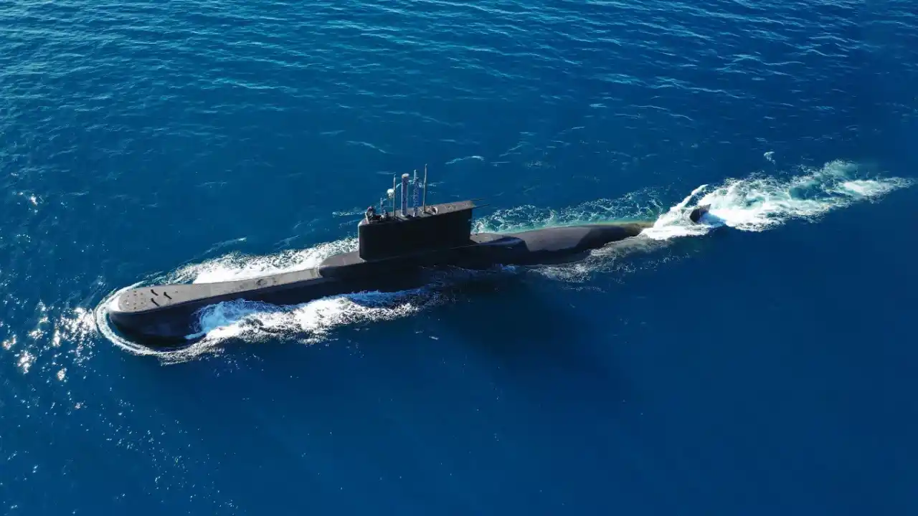

NAVSUP WSS – N97’s Operational Impact: Critical Fleet Support
N97 – Submarine & Maritime Industrial Operations Directorate
Provides integrated logistics, platform and weapons system program support for Industrial Operations and
availability planning & execution support for public and private submarine and surface CNO depot maintenance availabilities and the Navy’s Submarines through IWST management.
N97B
Special Emphasis
N976
Submarine Logistics
N974
Strategic Weapons Systems
N972
Directorate Support
N977
Maritime Industrial Directorate & Organic Repair Support Division
N971/N971F
IWST Integrator & Director, Platforms, Programs, & Suppliers
N975
Special Programs
Insert photo or graphic here
21

Slide 22
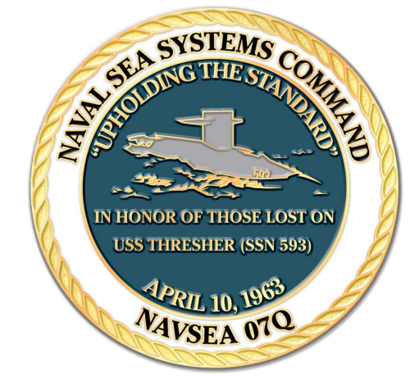
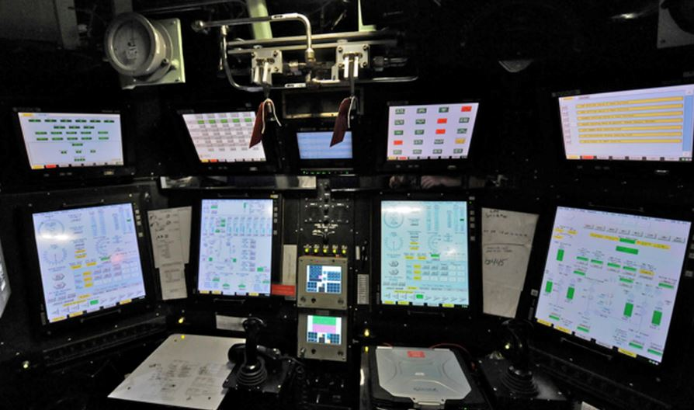
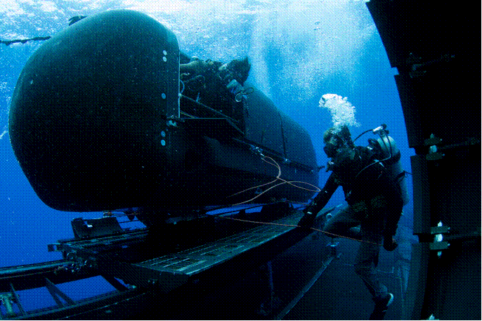
Level I / Navy Special Emphasis Programs (NSEP)
Level I / SUBSAFE
  Primary Purpose to designate components that require a high level of confidence in their material properties. This means the material's chemical composition and mechanical characteristics must meet strict specifications to ensure they can withstand the pressures and conditions they'll encounter.
  Level I / SUBSAFE certification is crucial for ensuring the safety of submarines and their crews. It provides maximum reasonable assurance that hull integrity is maintained to preclude flooding and that the submarine can recover from a flooding casualty.
Fly-By-Wire Ship Control System Program (FBW SCS)
  Primary Purpose is to provide maximum reasonable assurance that the FBW SCS will not cause a casualty or prevent ship recovery from flooding or control surface jam casualty.
  System-based safety program that incorporates the use of computers, electronics and software technology to control steering, diving, and hovering and depth control systems.
  FBW Submarine Flight Critical Components (SFCC) are safety critical electronic components within the FBW SCS Certification Boundary that process safety critical functions and/or data elements which affect a submarine’s ability to submerge, surface or maneuver with in the Submerged Operating Envelope.
Deep Submergence Systems – Scope of Certification (DSS-SOC)
  Primary purpose is to ensure the safety and operational readiness of manned deep submergence systems through rigorous design, construction, testing, and operational procedures. It provides maximum reasonable assurance that a material or procedural failure that imperils the operators or occupants will not occur.
  Material supports a small fleet of DSS-SOC certified submarines supporting Dry Deck Shelter (DDS) and Seal Delivery Vehicle (SDV) operations
  Legacy DDS in process of being redesigned and MK11 Seal Delivery Vehicle is currently replacing MK8 SDVs as they decommission
Insert photo or graphic here

Slide 23
Level I Stock Program Material Portfolio
Consumable Hardware
  Fasteners, Barstock, Weld Wires
  FSCs 5305, 5307, 5310, 9510, 9530, 3439
Valves and valve components
  Ball, 525, Standard, Combo Hull & Backup, Part Kits
  FSCs 4820, 4810
Fittings
  Hose, Pipe, Tube
  FSCs 4710, 4720, 4730
Hull Penetrators
  Electrical Hull Fittings, Connectors
  FSCs 3040, 2040, 4320
Misc.
Insert photo or graphic here

Slide 24
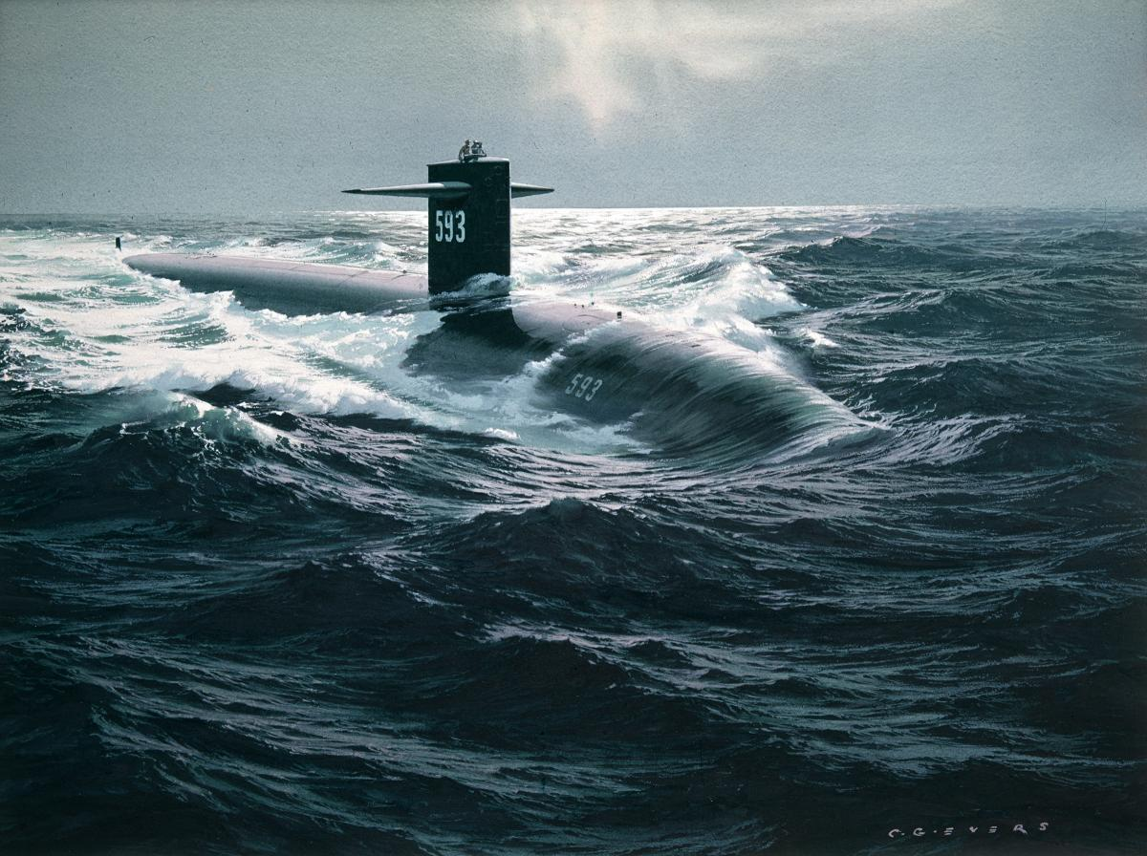
Vendor Qualification for NAVSUP WSS NSEP Contracts
How to get started…
…submit complete quote.
Read solicitation carefully
  Inspection & Test Plan
  Inspection System Procedures
Quality Assessment
  Quality Manual review and research
  Pre-award Survey (on site visit)
  Final report
Contracting Actions
Insert photo or graphic here
NAVSUP WSS is qualified to perform procurement of new, repaired, and refurbished stock system assets under the technical oversight of NAVSEALOGCEN. (NAVSEA Notice 5000)

Slide 25
NAVSUP WSS Code N23 Source Development and Approval
Presented by:
Code N2
Mr. Theo Williams

Slide 26

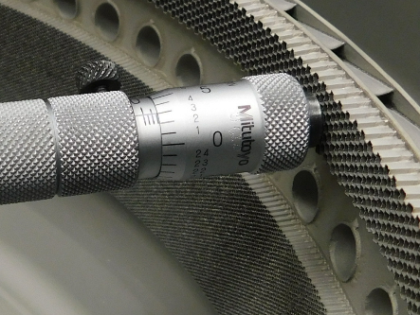
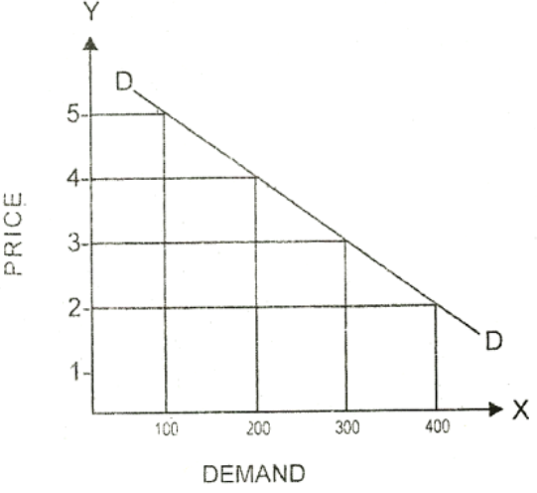
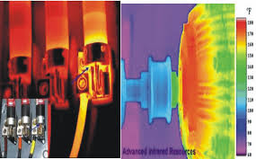
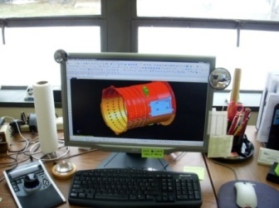
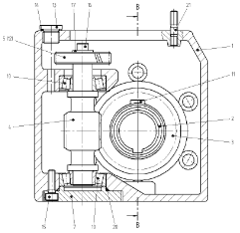
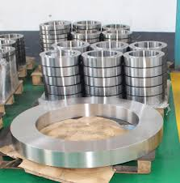


Supply Chain Challenges
- Low Demand / Requirements
- Highly specialized Non-destructive testing requirements
- Sole-Sourced Items
- IP Data rights/ special process specifications
- Obsolescence questions
- Lack of Technical Data / Drawings / Specifications
- Unique machining & inspection requirements
- GFE required to develop of a source
- Sourcing exotic or rare metals
- New Platforms, Long-term contracts with the Primes
Notes:
Theo – Talk as long as you want on this slide, detail can be dependent on whatever message the ops code is broadcasting

Slide 27
When is Source Approval Required?
The design control activity (NAVAIR/NAVSEA) determines when a part requires engineering source approval in order to maintain the quality of the part.
  This determination results in:
    Aviation parts being designated Critical Application or Critical Safety Items
    Maritime parts being classified as Level-1/Sub-Safe, Deep-Sea Submergence, Nuclear Plant Material, etc.
An alternate source must be approved in accordance with the design control activity’s (NAVAIR/NAVSEA) procedures and qualified by the cognizant Naval engineering activity.
  The qualification procedures must be approved by the Naval engineering activity having technical authority over the part in the intended application.
    Approval/Qualification for Aviation Items: NAVAIR for CSI, NAVSUP for CAI.
    Approval/Qualification for Maritime Items: Work with NAVSUP IWST to obtain requisite NAVSEA approvals.
  Source: Acquisition Method Suffix Code (AMSC): C
Notes:
This slide answers the yes/no question of will some sort of engineering approval be required, and tee’s up the appropriate pathway to achieve that approval.

Slide 28

Aviation - Source Approval Criteria
SAR packages for a specific subject item are categorized based on the manufacturer’s previous work.
There are 4 Categories, NAVSUP WSS can only accept Category I and Category II SARs.
Actual Item
The proposing manufacturer has produced the exact same item for the OEM or for another U.S. Government activity within the past:
- 3 years for CSIs
- 5 years for CAIs
Similar Item
The proposing manufacturer has produced a similar item for the OEM or another U.S. Government activity.
Similarity comparison includes: complexity, design, manufacturing processes, materials, application and operating environment.
SAR Categories
Category I
Category II
Notes:
What are the other Categories?
Category III – New Manufacture of Item - will not be reviewed by the NAVSUP.
Category IV – Alternate Item (Reverse Engineering) - will not be reviewed unless the Navy has specifically requested a reverse engineering effort.

Slide 29
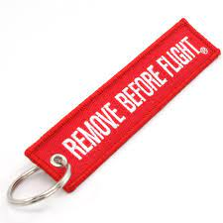
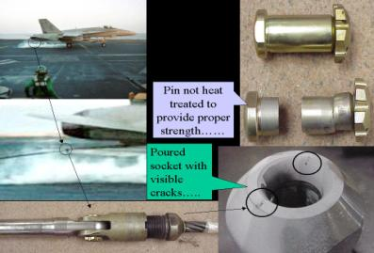
Aviation - Criticality Designations
Critical Application Item
(CAI)
Critical Application Item (CAI): An item that is essential to weapon system performance or operation, or the preservation of life or safety of operating personnel, as determined by the military services.
>> The subset of CAIs whose failure could have catastrophic or critical safety consequences is called CSIs.
Non-Critical
(NC)
Critical Safety Item
(CSI)
Critical Safety Item (CSI): A part, assembly, or support equipment for an aircraft or aviation weapons system that contains a characteristic any failure, malfunction, or absence of which could cause a catastrophic or critical failure resulting in the loss or serious damage to the aircraft or weapons system, an unacceptable risk of personal injury or loss of life, or an un-commanded engine shutdown that jeopardizes safety. Damage is considered serious or substantial when it would be sufficient to cause a “Class A” accident or A mishap of severity category I.
>> The determining factor in CSI is the consequence of failure, not the probability that the failure or consequence would occur.
Notes:
Continuation from the previous slide about engineering approval, if Non-Critical, no approval. If CAI or CSI, then approval required. Fundamentally, criticality determinations boils down to the consequence of failure (not probability); CAIs are essential to weapon system performance, whereas CSI could cause critical failure/loss of life.

Slide 30
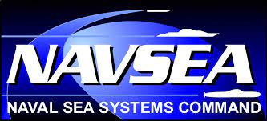

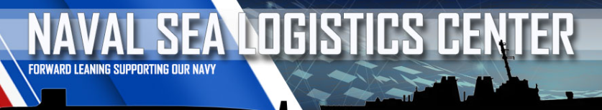
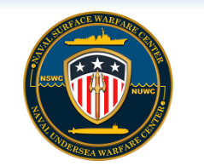
Maritime - Source Development Areas
There are many types of Engineering Approvals across the Maritime Domain, surface and sub-surface, for example:
  Deep Sea Submergence (DSS)
  Level-1(L1)/Sub-Safe (SS)
  Nuclear Plant Material (NPM)
  NAVSEA Weld Procedures
  NAVSEA NDT Procedures
  Qualified Products Lists (QPL)
    Consumable Items (DLA QPL)
    Repairable Items (NAVSEA/NAVSUP QPL)
These approvals can be achieved by working with NAVSUP WSS Maritime contracting officer via the Mechanicsburg DoDAAC: N00104, and NAVSEA Engineering Support Activity (NSLC, NUWC, NSWC).
*stock photo
If an item falls into one of the above category’s, Engineering Approval must come from NAVSEA.
If an item falls outside the above categories (not an *NSEP SMIC), WSS can award without engineering approval
Regardless of designation, NAVSUP WSS will help vendors become sources in the MIB.
*NSEP SMICs: L1, SS, C1, SB, S1, Q3, Q5, VG, X1-X8, DG, DO,D4, D5, D6, D7, & D8.
Notes:
Foot stomp, repeat this as many times as you can - Work with the KO, notify N23 of effort to achieve NAVSEA ISEA qualification.
Acronyms: NSEP SMIC – Navy Special Emphasis Program, Special Material Identification Code

Slide 31
Source Development Engagement
Our Process and how it benefits your business:
Validate the Criticality
Verify criticality of aviation parts and determine if a SAR is required and what category, either:
Validate Technical Data Package
Verify complete TDP including:
Vendor SAR support
Reengage with the potential source and provide all the information obtained during the internal process
Verify Distribution Statements for government release requirements
Provide insight on the Navy SAR process which includes the latest Navy SAR brochure
Deliver guidance on appropriate SAR Category
Assisting Integrated Weapons System Team (IWST)
Engage with IWST to validate open solicitations & Sources Sought notifications (i.e. ability to breakout)
Verify demand (as required)
CAI & CSI
All sub-component drawings, OEM specifications
Ensure data is free of any source control or vender control statements
Inform the IWST of a possible second source for additional competition
Approve additional capability when additional source of supply requirements apply
Non-Critical items: do not
require Source Qualification
Answer questions on SAR Checklist Criteria
Forward to appropriate NAVAIR Technical Authority for Final Approval (CSI only)
We want our partners to be confident that they are making a sound business decision by choosing to work with USN.
Notes:
Unsolicited SAR Submission: If a vendor inquires about submitting a SAR for a component without an active solicitation, expect this level of support from N23.
Assisting the IWST: We will determine what the USN sustainment strategy (as there is no open solicitation); we will provide feedback to the submitting vendor, centered on what the Navy needs (or doesn’t need).

Slide 32
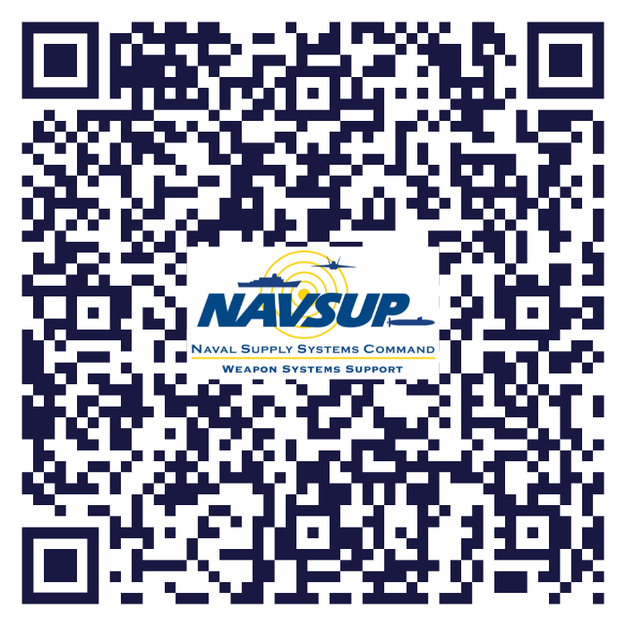
Aviation SAR Brochure Tips
NAVSUP WSS is the SAR submission Focal Point for USN Aviation.
Please reach out to the solicitation POC if you are interested supporting the USN, regardless if you are an approved source.
SAR Tips:
  Follow alphabetical ordering convention for the information requirements laid out in the brochure.
  When submitting on Same or Similar item, please ensure you provide historical contract information (with government).
  Any items left blank will result in an immediate rejection; contact N23 if you have any questions regarding content.
QR Code leads to all NAVSUP SAR Brochures:
Spares
Repairs
Additive Manufacturing
Notes:
Remind the audience that connecting with WSS (KO, N23) early and often is a best practice. WSS spends billions of dollars, and issues hundreds of thousands of solicitations year, through a limited work force. WSS is a fast-paced environment.

Slide 33

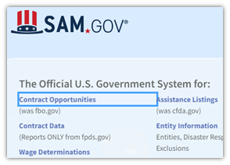

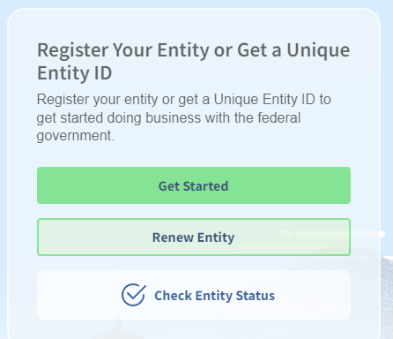



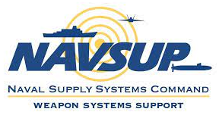
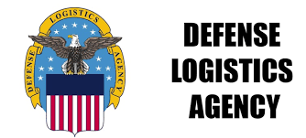
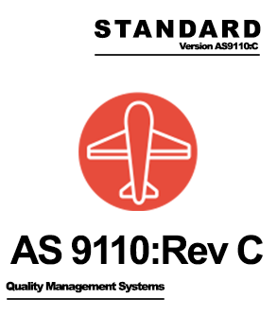

Business Opportunities
Can you Manufacture or Repair
Maritime or Aviation components?
Finding Business Opportunities:
Certified / Compliant:
Know your customer:
Defense Logistics Agency
Notes:
Solicitations supporting USN fleet are posted on SAM, NECO, and DIBBS.
NAVSUP heavy focus on Repairables, DLA heavy focus on consumables (spares).
Small Businesses: You do NOT need to be certified (costs money, though it helps), only compliant with ISO, AS, etc.

Slide 34
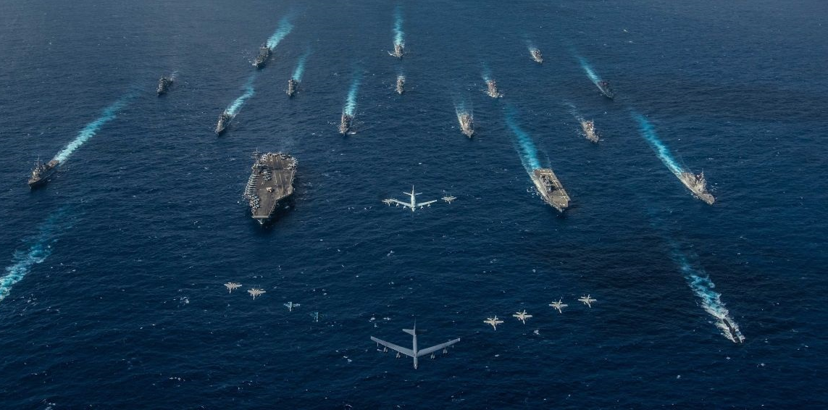
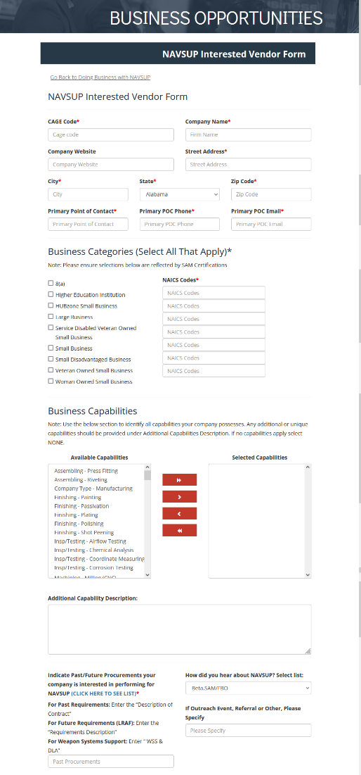
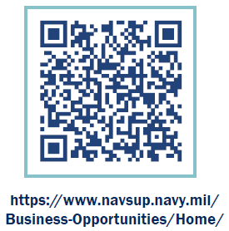

Please visit our booth!

